Slide 1
Research Questions
How does seasonality influence the occurrence of algal blooms within Loch Leven?
What are the drivers (chemical and physical) of algal blooms in Loch Leven?
How does environmental drivers influence the composition of phytoplankton communities within Loch Leven?

Slide 2
Variables | Ranking for lmer | References | Notes
SRP | 1 | 10.1007/s10750-011-0923-x 10.1111/j.1365-2427.2007.01865.x 10.1080/20442041.2020.1827891 10.1007/s10750-013-1525-6 10.1016/j.ecolind.2022.109560 10.1016/j.hal.2019.02.002 | Nutrient availability (10.1016/j.envpol.2020.116210)
SD | 9 | 10.1007/s10750-011-0923-x
NO3 | 3 | 10.1007/s10750-011-0996-6 10.1007/s10750-013-1525-6 10.1016/j.ecolind.2022.109560 10.1016/j.hal.2019.02.002 | Total N played a more important role for phytoplankton richness than total P (10.1007/s10750-011-0996-6)
Salinity |  | 10.3390/w15061116 | Talks about salinity in brackish coastal lakes – relevant?
Daphnia | 4 | 10.100 7/s10750-011-0923-x
DO | 8 | 10.1080/20442041.2020.1827891
pH | 5 | 10.1007/s10750-013-1525-6 10.1016/j.ecolind.2022.109560
Temperature | 6 | 10.1007/s10750-011-0923-x 10.1080/20442041.2020.1827891 | Some found that temperature had little effect (10.1111/j.1365-2427.2007.01865.x) Spilt findings
Water Depth | 7 | 10.1016/j.ecolind.2022.109560
Phytoplankton Group | 2
Season | 2 | 10.1016/j.ecolind.2022.109560 | the plankton community was the least diverse in winter and the most stable during the spring-to-summer transition

Slide 3
Mod No | Response Variable | Fixed Effect |  |  |  |  |  |  | Interaction Terms | AIC | R²
 |  | Soluble Reactive Phosphorus | Season | Phytoplankton Group | Nitrate | Daphnia | Temperature | Water Level | Season* Phytoplankton Group
1 | Total Biovolume | -0.017±0.0099 | - | - | - | - | - | - | - | 450.76 | 0.029
2 | Biovolume | -0.013±0.0063 * | *** | *** | - | - | - | - | *** | 2063.55 | 0.047
3 |  | 0.0096±0.014 | ** | *** | -0.043±0.29 | - | - | - | *** | 703.45 | 0.44
4 |  | 0.0058±0.014 | ** | *** | -0.17±0.30 | -0.040±0.018 * | - | - | *** | 706.83 | 0.45
5 |  | 0.0031±0.014 | ** | *** | -0.056±0.32 | -0.046±0.020 * | 0.057±0.063 | - | *** | 711.71 | 0.46
6 |  | 0.0020±0.014 | * | *** | 0.16±0.34 | -0.040±0.019 * | 0.069±0.063 | -1.21±0.55 * | *** | 693.12 | 0.47
7 |  | 0.017±0.040 | N.S. | ** | -0.38±1.54 | -0.16±0.051 ** | 0.093±0.15 | -2.03±0.93 * | *** | 287.64 | 0.50

Slide 4
Mod No | Intercept | Season |  |  | Phytoplankton Group |  |  | Season*Phytoplankton Group
 | Cryto : Winter | Spring | Summer | Autumn | Cyano | Diatoms | Greens | Cyano : Spring | Diatoms: Spring | Greens: Spring | Cyano : Summer | Diatoms : Summer | Greens : Summer | Cyano : Autumn | Diatoms : Autumn | Greens : Autumn
1 | - | - | - | - | - | - | - | - | - | - | - | - | - | - | - | -
2 | 11.23± 0.29 *** | 1.26± 0.36 *** | 1.86± 0.36 *** | 1.08± 0.36 ** | -0.94± 0.38 * | 3.82± 0.38 *** | 0.58± 0.38 | -0.13± 0.51 | -1.78± 0.50 *** | -0.80± 0.50 | 0.94± 0.51 | -3.44± 0.50 *** | -1.07± 0.50 * | 0.92± 0.51 | -0.64± 0.51 | -0.40± 0.51
3 | 10.11± 0.78 *** | 2.04± 0.74 ** | 2.60± 0.84 ** | 1.01± 1.08 | -0.14± 0.78 | 5.20± 0.76 *** | 1.39± 0.76 | -1.02± 1.06 | -3.06± 1.03 ** | -1.46± 1.03 | 0.40± 1.06 | -5.05± 1.03 *** | -2.06± 1.03 * | 1.01± 1.08 | -1.20± 1.06 | -0.87± 1.06
4 | 10.44± 0.79 *** | 2.24± 0.74 ** | 2.68± 0.83 ** | 1.38± 0.88 | -0.12± 0.77 | 5.20± 0.75 *** | 1.39± 0.75 | -1.01± 1.05 | -3.07± 1.02 ** | -1.46± 1.02 | 0.34± 1.04 | -5.05± 1.02 *** | -2.06± 1.02 * | 0.99± 1.06 | -1.19± 1.05 | -0.86± 1.05
5 | 10.06± 0.89 *** | 2.03± 0.77 ** | 2.12± 1.03 * | 1.13± 0.92 | -0.13± 0.77 | 5.20± 0.75 *** | 1.39± 0.75 | -0.99± 1.06 | -3.07± 1.02 ** | -1.46± 1.02 | 0.35± 1.04 | -5.05± 1.02 *** | -2.06± 1.02 * | 1.02± 1.07 | -1.18± 1.05 | -0.85± 1.05
6 | 139.42± 58.95 * | 1.97± 0.76 * | 2.32± 1.04 * | 0.97± 0.91 | -0.10± 0.76 | 5.20± 0.74 *** | 1.39± 0.74 | -1.06± 1.05 | -3.07± 1.01 ** | -1.46± 1.01 | 0.12± 1.06 | -5.41± 1.03 *** | -2.31± 1.03 * | 1.02± 1.05 | -1.14± -1.04 | -0.82± 1.04
7 | 226.14± 100.19 * | 2.17± 1.73 | 1.64± 1.95 | -0.88± 2.20 | 0.56± 1.83 | 5.81± 1.83 ** | 0.34± 1.83 | -1.91± 2.24 | -3.70± 2.24 | -0.005± 2.24 | -1.43± 2.11 | -6.42± 2.11 ** | -1.91± 2.11 | 0.52± 2.16 | -1.20± 2.16 | 0.56± 2.16

Slide 5
How to test the effect of seasonality on phytoplankton groups
When reporting differences report using actual biovolumes (unlog)\
Flushing rate

Slide 6
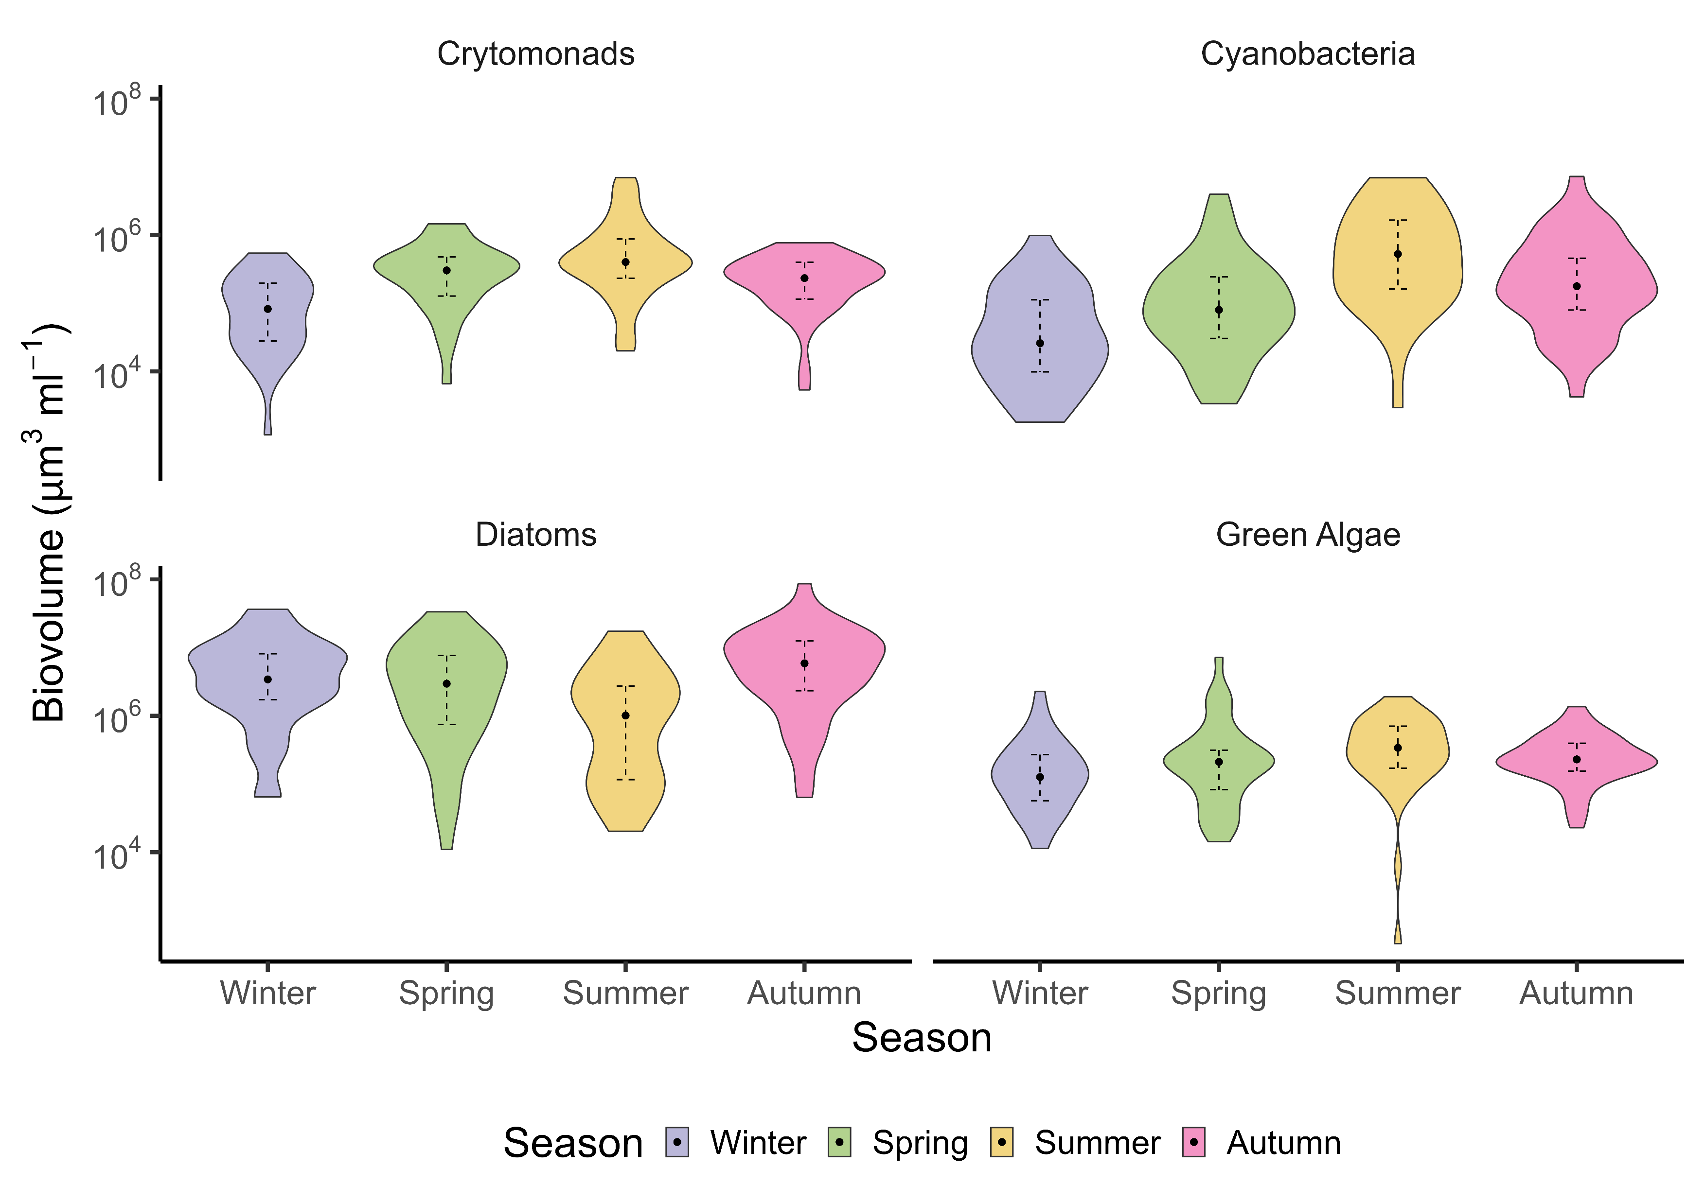
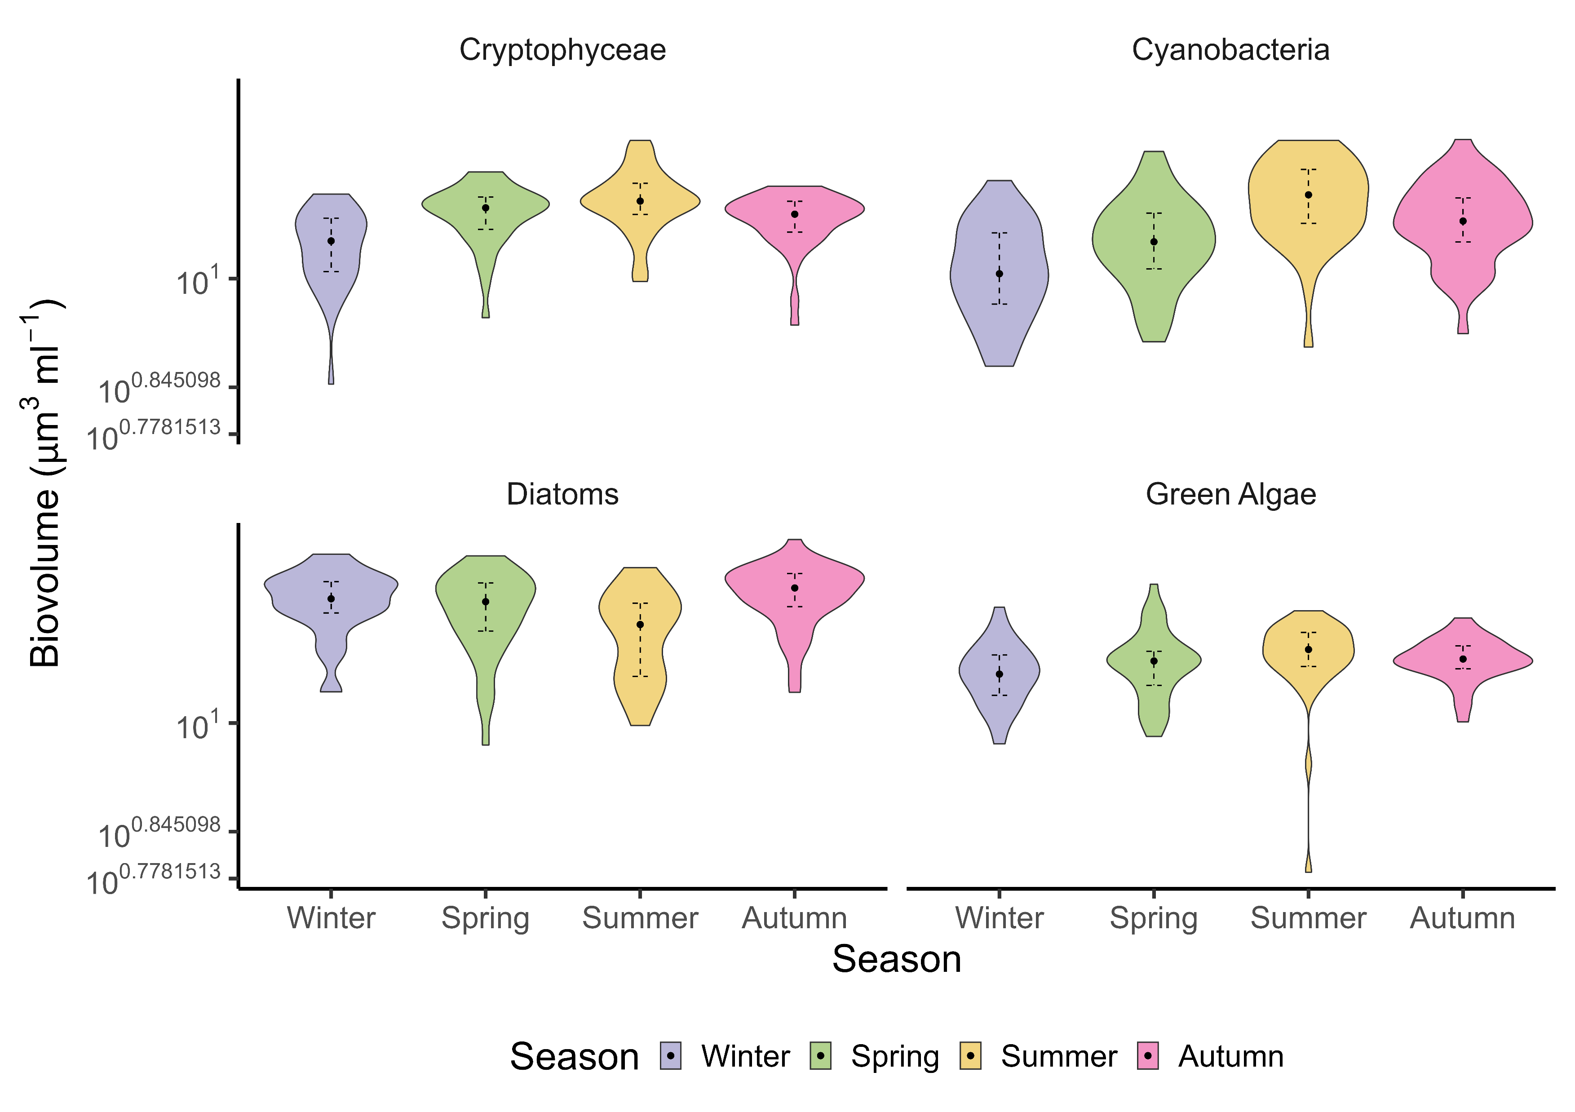
BC *
BC *
B
A
B
B
A
B
A
AB **
A
B
A
A
AB ***
A

Slide 7
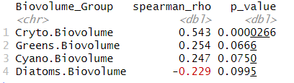
Seasonal Daphnia Trends
Spearman correlation between daphnia and each phytoplankton group

Slide 8
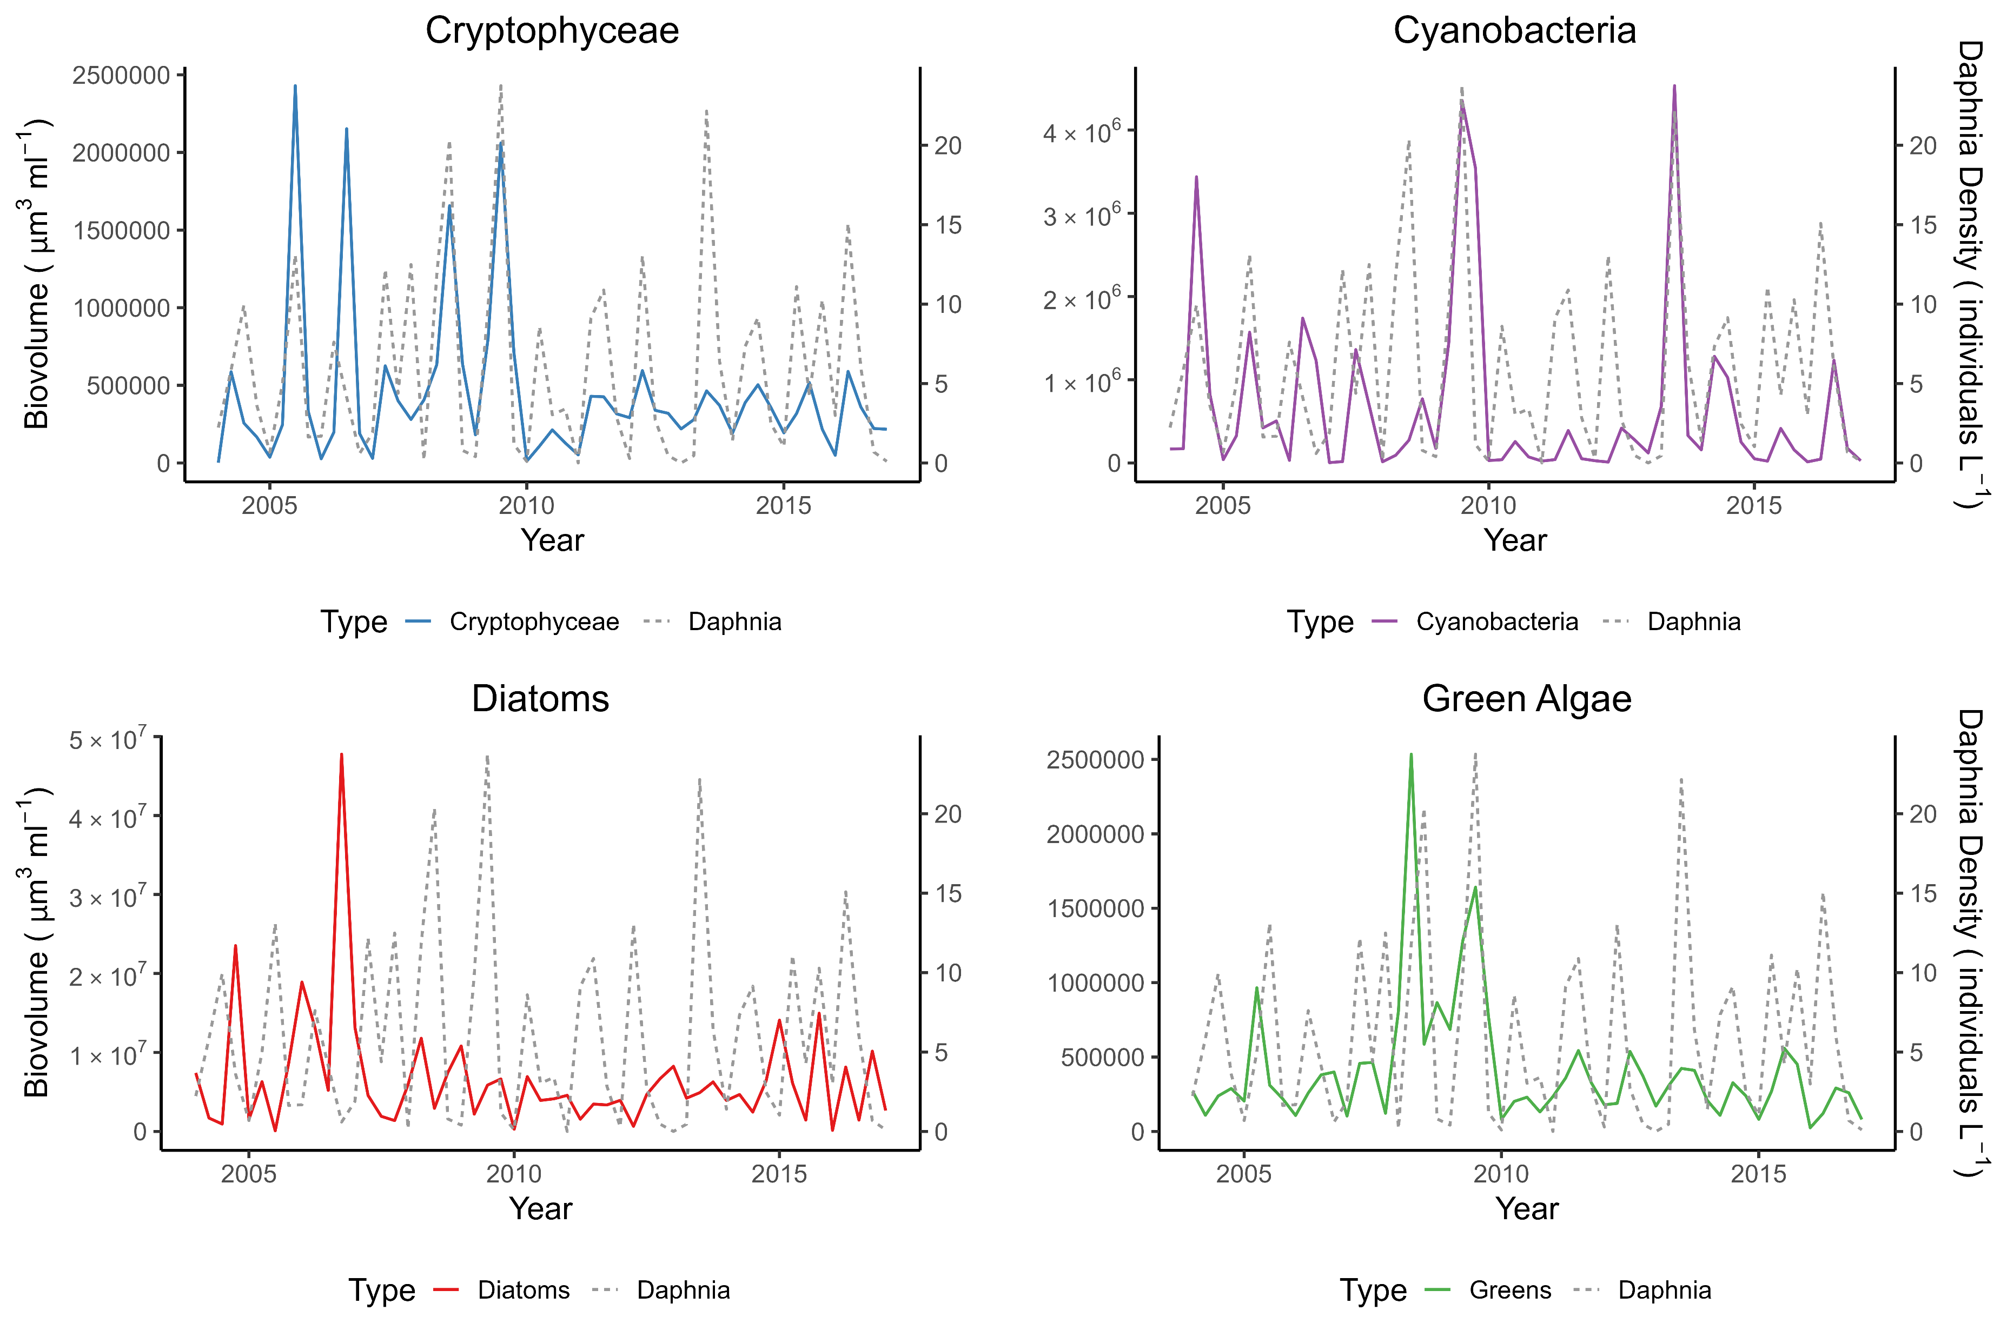
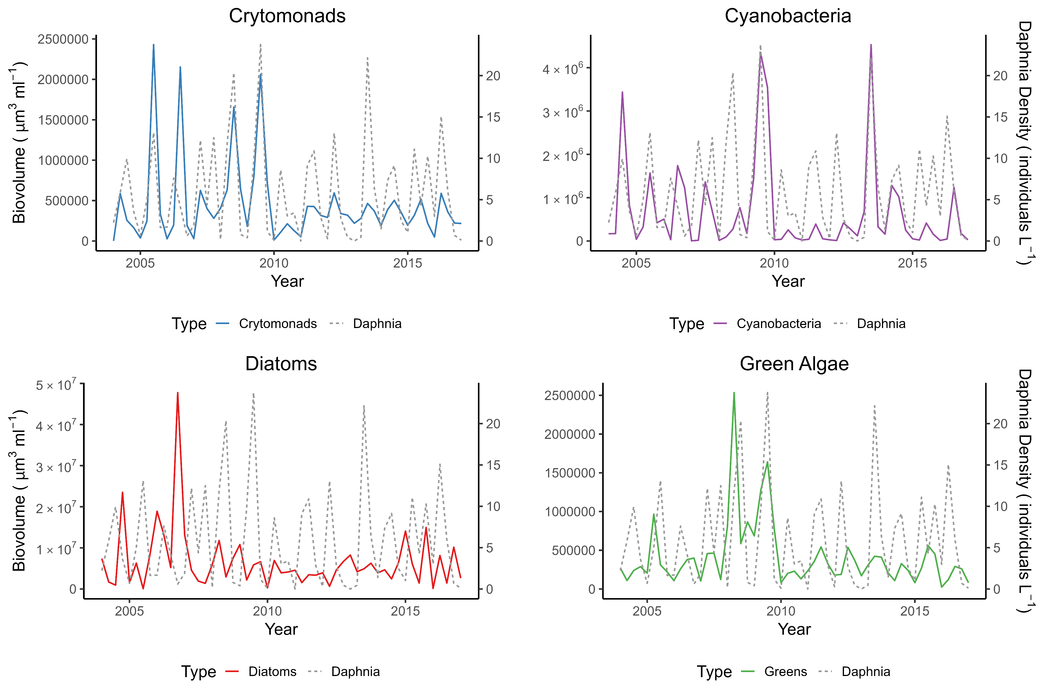
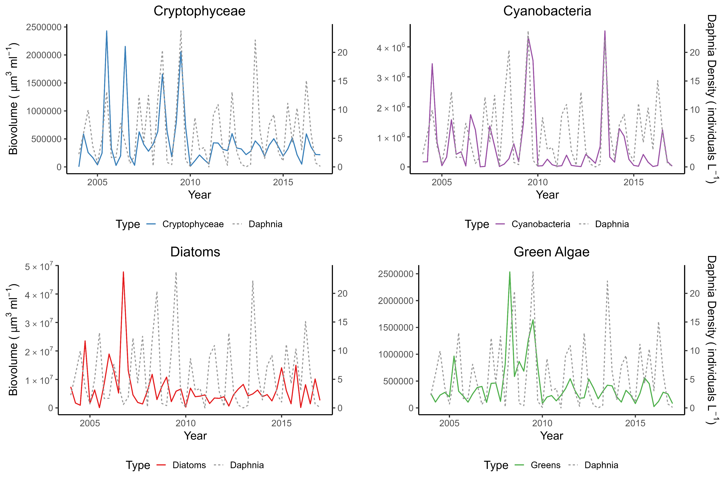
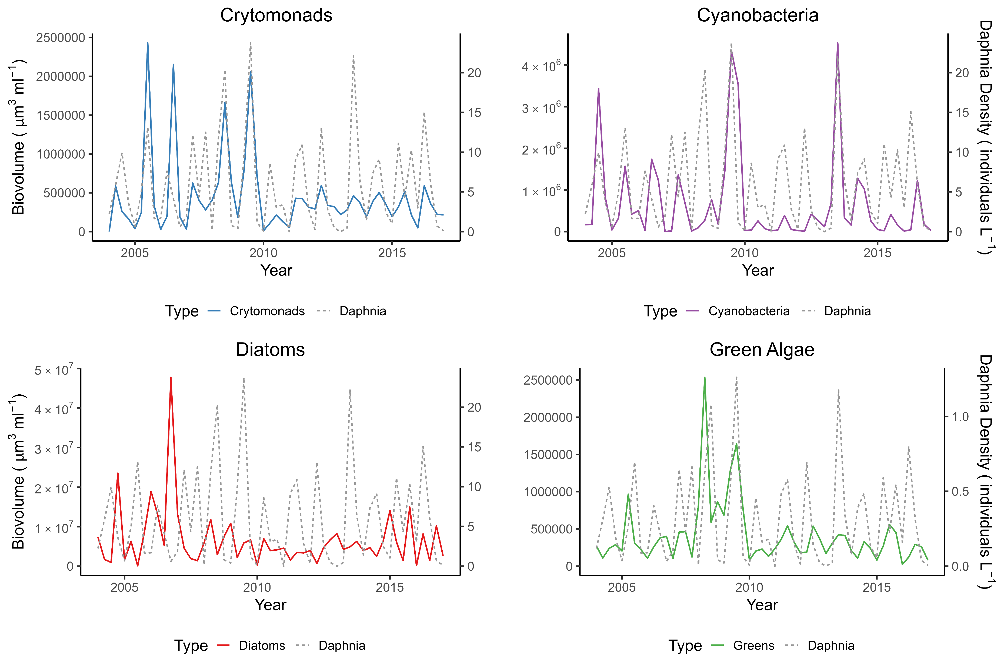


ρ = 0.543 ***
ρ = 0.254
ρ = 0.247
ρ = -0.229

Slide 10
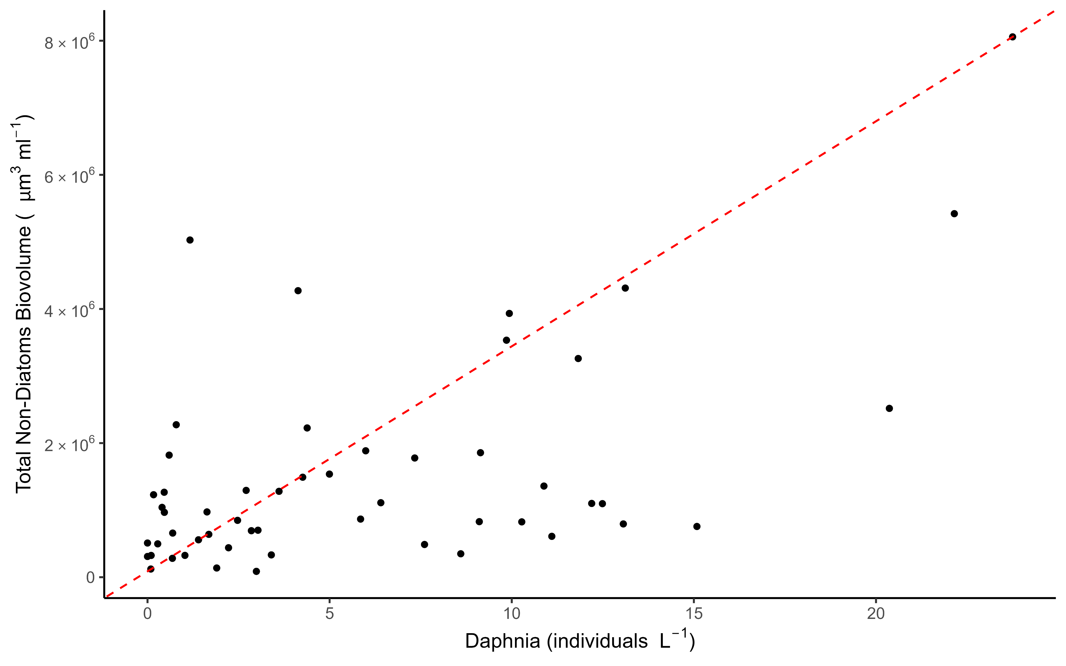

Slide 11
Random forest regression
Imputed data
NAs removed
% increase Means Squared Error
Measures how much the model’s Mean Squared Error (MSE) increases when a variable is removed.
Higher values mean the variable is more important for prediction.
Increase in Node purity
Measures how much each variable contributes to node purity in the decision trees.
Higher values indicate more influence in splitting decisions.
%IncMSE is better for understanding predictive power, while IncNodePurity focuses on tree structure.

Slide 12
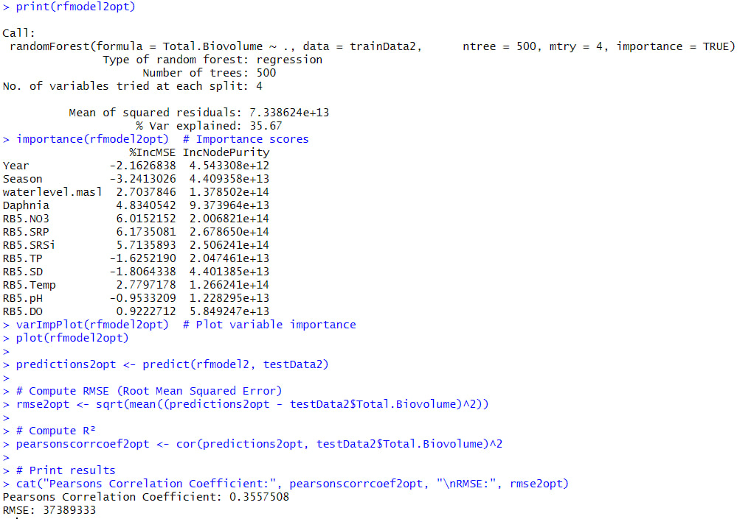

Slide 13
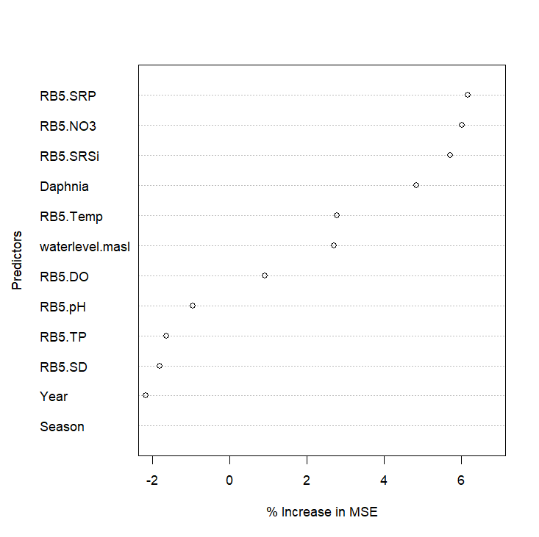

Slide 14
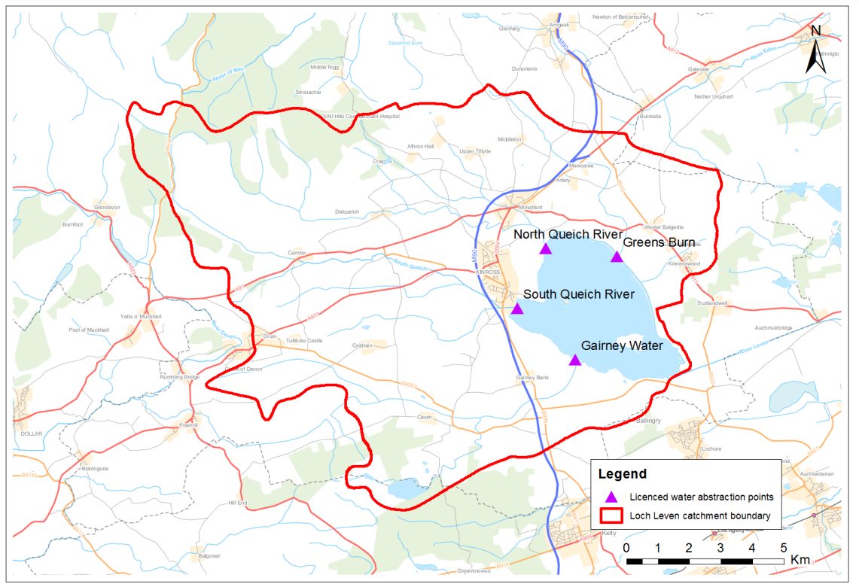
Main Inflow points
Loch Leven catchment boundary

Slide 15
